Slide 1
OS Introduction 1
David Liu
SP 2022

Slide 2
Learning Objectives
Discuss the role and importance of operating systems
Describe the general organization of a computer system and the role of interrupts
Describe the components in a modern, multiprocessor computer system
Illustrate the transition from user mode to kernel mode
Discuss how operating systems are used in various computing environments
Provide examples of free and open-source operating systems

Slide 3
What Operating Systems Do?
User view
System view
Resource allocator
Program controller

Slide 4
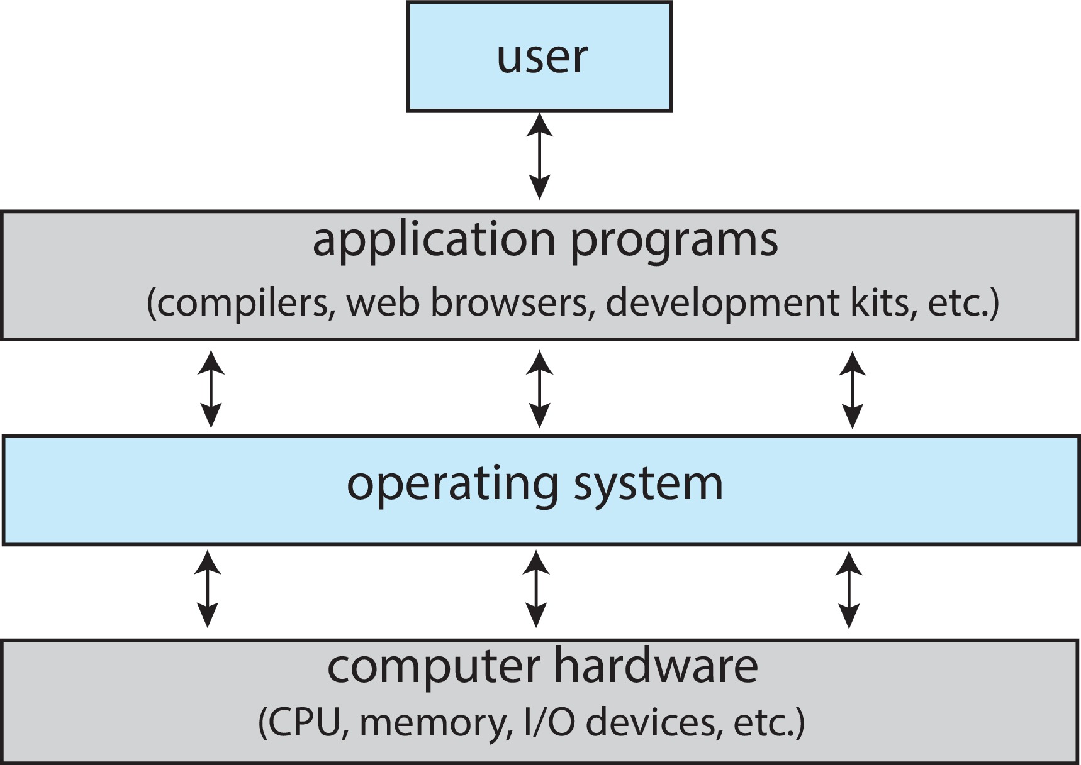
Operating System Definition
No completely adequate definition of an OS

Slide 5
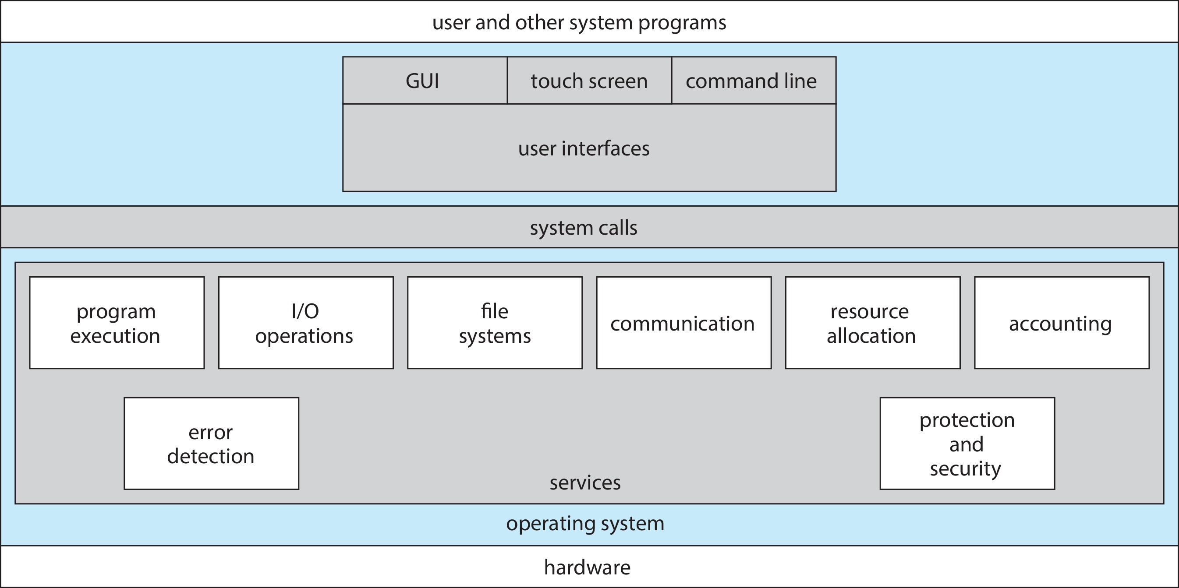
OS Common Definition
The One program running at all times on the computer
“Kernel”

Slide 6
Why Study Operating Systems?
Proper, efficient, effective, secure programming

